Slide 1
Separating concerns with RubigoNavigator
an opinionated navigator using Flutter's Navigator 2.0
https://yapb.dev/
https://twitter.com/jsroest
https://github.com/jsroest
https://www.linkedin.com/in/sanderroest/

Slide 2
Agenda
Designing a sample app, to show the use case of this navigator.
The problem and a solution.
Navigator 2.0 and RubigoNavigator.
RubigoNavigator overview (classes and events).
Let me see the code…. live demo.
Package 'mason', to generate page/controller pairs.

Slide 3
Quality Control app According the customer: "A really simple app"
Let's find out…
Requirements:
Get a list of 'items to check' from a webservice.
The user chooses an item from the list. If just 1 item, continue automatically.
The user checks the item. Result is 'ok' or 'not ok'.
Send the result back via a webservice and remove the item from the list.
Repeat until all items are checked.

Slide 4


Design
S100
S200
S210
S220
S230
Main menu
Quality Control
----------------------
Settings
Select item
Item: 1
Elect. Assembly
--------------------
Item: 2
Steel case
--------------------
Item: 3
Power cord
Check item
Item: 2
Steel case
Ready
All checks are done…
Info
No items to check.
OK
NOT OK
WS01 GetQualityControlItems
WS02
SetQualityControlItem

Slide 5
No quality check items found
S100
S200
S230
Tap 'Quality Control'
Animate from S100 to S200
Execute WS01, show spinner
Animate from S200 to S230
Wait 2 seconds
Animate from S230 to S100
Combine step 2 and 4 Animate from S100 directly to S230
Main menu
Quality Control
----------------------
Settings
Select item
Info
No items to check.
WS01
GetQualityControlItems

Slide 6
Only one item
S100
S200
S210
S220
Tap 'Quality Control'
Animate from S100 to S200
Execute WS01, show spinner
Animate from S200 to S210
Tap 'OK'
Execute WS02, show spinner
Animate from S210 to S200
Animate from S200 to S220
Wait 2 seconds
Animates from S220 to S100
Combine step 2 and step 4:
Animate from S100 directly to S210
Combine step 7 and step 8
Animates from S210 directly to S220
Main menu
Quality Control
----------------------
Settings
Select item
Item: 2
Steel case
Check item
Item: 2
Steel case
Ready
All checks are done…
OK
NOT OK
OK
WS01
GetQualityControlItems
WS02
SetQualityControlItem

Slide 7
Problem
If we want to separate concerns, we might have an issue with pages that animate quickly after each other.
If we want to solve that with Navigator 1.0, code becomes complicated and/or spaghetti and violates separation of concerns.

Slide 8
Solution
RubigoNavigator
A navigator, that informs Flutter's standard navigator about page changes when navigation is completed.
Made possible by Flutter's Navigator 2.0

Slide 9
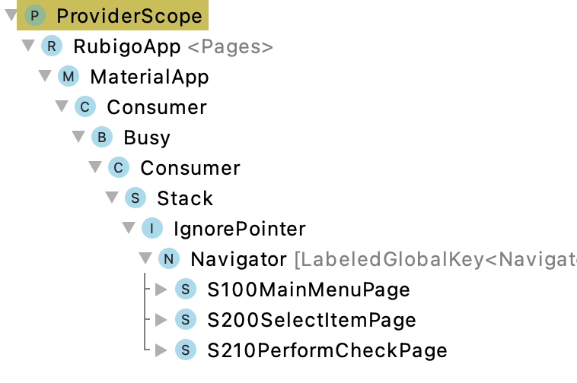
Navigator 2.0
MaterialApp( navigatorKey: _navigatorKey, onGenerateRoute: (_) => null, title: 'Flutter Navigator Demo', builder: (context, _) { return Consumer( builder: (context, watch, child) { return Busy( child: Navigator( key: _navigatorKey, pages: watch(widget.navigatorProvider).pages, onPopPage: context.read(widget.navigatorProvider).onPopPage, ), ); }, ); }, )
List of Pages
Page(child: S100MainMenuPage());
Page(child: S200SelectItemPage());
Page(child: S210PerformCheckPage());

Slide 10
Navigator 2.0 and RubigoNavigator
Rubigo Navigator
List of all available controllers
S100MainMenuController
S200SelectItemController
S210PerformCheckController
S220AllRowsDoneController
S230NoRowsFoundController
S900SettingsController
Rubigo Navigator
Stack of controllers
S100MainMenuController
S200SelectItemController
S210PerformCheckController
Navigator 2.0
List of Pages
S100MainMenuPage
S200SelectItemPage
S210PerformCheckPage
App starts with page of first controller in list
When stable
Methods
Push
Pop
PopTo
Remove
Events
onTop
willShow
mayPop
onTop()

Slide 11
Implementation
Classes:
RubigoApp Convenience widget for easy initial app setup
RubigoNavigator<Pages> Navigator of type Pages. Strongly typed navigation
RubigoController Business logic and state
RubigoPage View

Slide 12
RubigoNavigator<Pages>
Methods:
pop() Pops the current page of the stack
push(enum id) Pushes the page with id on the stack
popTo(enum id) Pops directly to the specific page
remove(enum id) Removes page with id unconditionally from the stack

Slide 13
RubigoController (base class)
Properties:
rubigoNavigator Allows easy access to navigation
Events:
onTop(stackChange, previousPage) In this event the navigation can be continued (push/pop/popTo)
willShow() This event can be used to get data (also from async sources) for the page to display. The page transition will take place, right after this event.
bool mayPop() This function can be used to block a pop().

Slide 14
RubigoPage (base class)
Properties:
controllerProvider Allows easy access the corresponding Controller

Slide 15
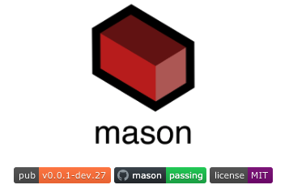

Mason
Use 'mason' to generate pairs of pages and controllers.
prompt> mason make rubigo_page
page_id: s300
page_name: item_search
✓ Made brick rubigo_page (5.6ms)
✓ Generated 2 file(s):
pages/s300_item_search/s300_item_search_controller.dart (new)
pages/s300_item_search/s300_item_search_page.dart (new)
Notes:
Show the source, demo the app. Investigate the output on the console see what's happening behind the scenes.
In Terminal window of Android Studio type:
mason make rubigo_page
page_id: s300
page_name: item_search
s300_item_search_page.dart
Change title to "Item search"
s300ItemSearchController
Add onTop, willShow and mayPop
pages.dart
Add s300ItemSearch to enum
Add Pages.s300ItemSearch: s300ItemSearchControllerProvider to list of controllers
s100_main_menu_page.dart
Add:
Divider(), ListTile( leading: Icon( Icons.search, size: 48.0, color: Colors.blue, ), title: Text( 'Settings', style: TextStyle(fontWeight: FontWeight.bold, fontSize: 24.0), ), onTap: context.read(controllerProvider).onItemSeachTap, )
s100_main_menu_page.dart
Add:
void onItemSearchTap() { rubigoNavigator.push(Pages.s300ItemSearch); }
s300_item_search_controller.dart
Add:
Show mayPop (false / true)
Show onTop => navigate directly to s200SelectItem
Add:
final BusyService _busyService
await _busyService.protect(() => Future<void>.delayed(Duration(seconds: 4)));
Show app is protected against taps

Slide 16

Live coding What can go wrong?
Notes:
Demo the app. Investigate the output on the console see what's happening behind the scenes.
Show the source.
In Terminal window of Android Studio type:
mason make rubigo_page
page_id: s300
page_name: item_search
s300_item_search_page.dart
Change title to "Item search"
s300ItemSearchController
Add onTop, willShow and mayPop
pages.dart
Add s300ItemSearch to enum
Add Pages.s300ItemSearch: s300ItemSearchControllerProvider to list of controllers
s100_main_menu_page.dart
Add:
Divider(), ListTile( leading: Icon( Icons.search, size: 48.0, color: Colors.blue, ), title: Text( 'Settings', style: TextStyle(fontWeight: FontWeight.bold, fontSize: 24.0), ), onTap: context.read(controllerProvider).onItemSeachTap, )
s100_main_menu_page.dart
Add:
void onItemSearchTap() { rubigoNavigator.push(Pages.s300ItemSearch); }
s300_item_search_controller.dart
Add:
Show mayPop (false / true)
Show onTop => navigate directly to s200SelectItem
Add:
final BusyService _busyService
ref.watch(busyServiceProvider),
await _busyService.protect(() => Future<void>.delayed(Duration(seconds: 4),),);
Show app is protected against taps

